Slide 1
Supply Chain Traceability in the Digital Age
Dr. Wafaa Ahmed

Slide 2
What will I cover today?
Supply chain traceability – why is it needed?
Blockchain-enabled supply chain traceability
Blockchain case studies

Slide 3




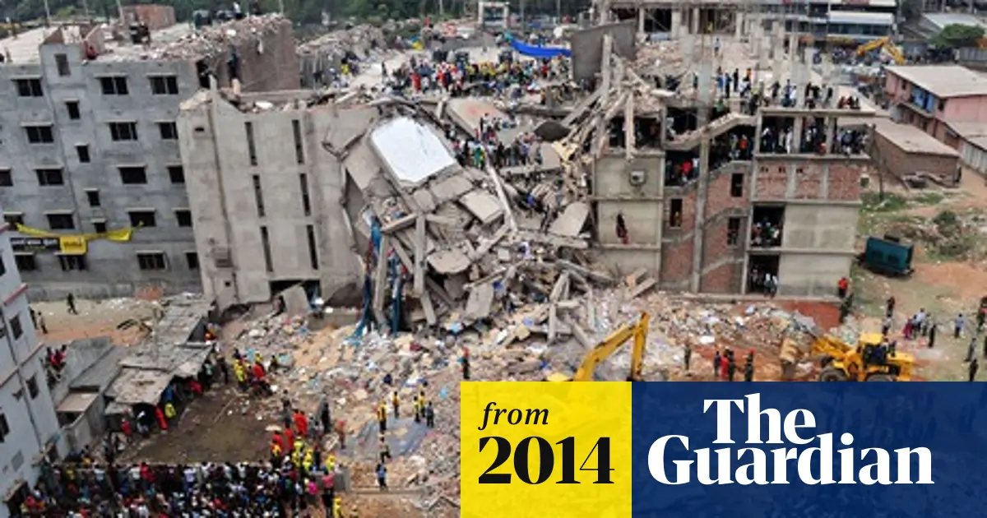

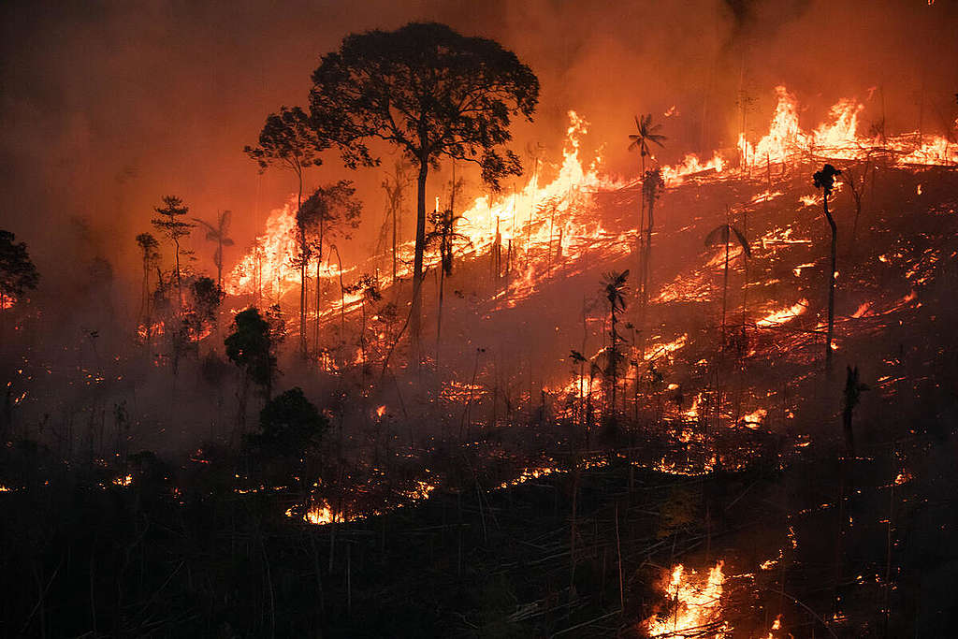
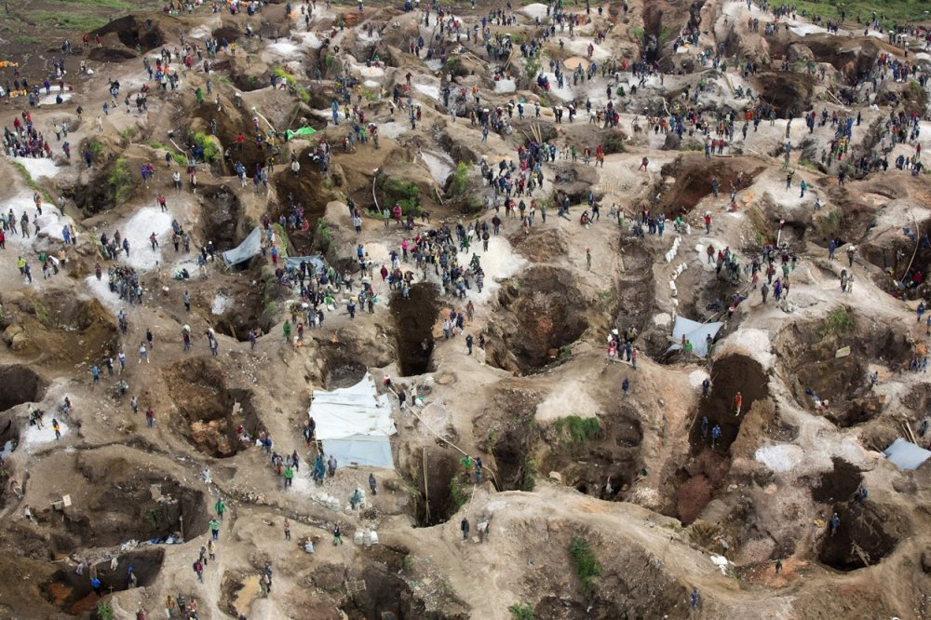
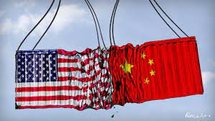
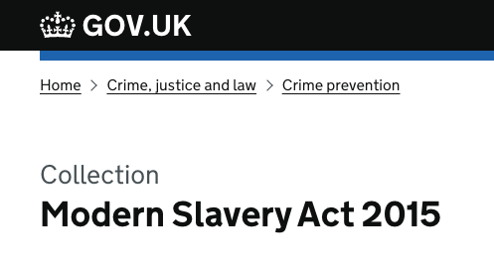
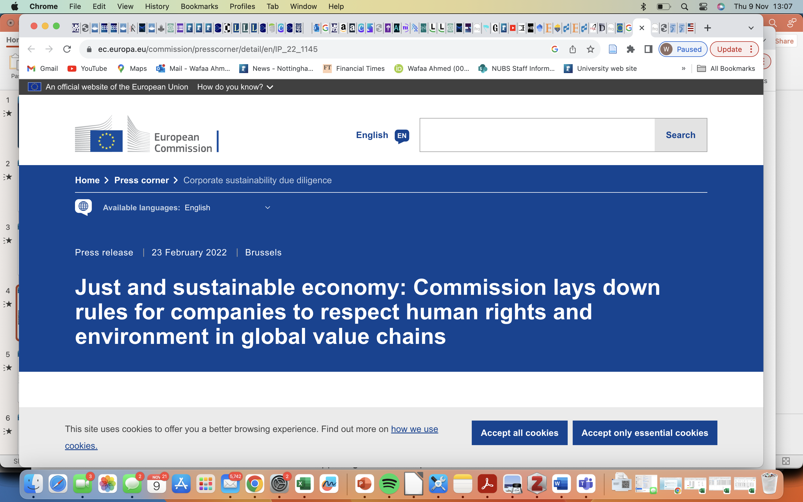
Supply chain traceability – why is it needed?
Notes:
supply chains are very much in the news, gaining strong attention from the public, greater focus than ever from industry, and much more scrutiny from governments
Consumers and societies ask more questions than ever before about products, their origin and the methods, materials, and people used in their production. Millennials and Generation Z exhibit stronger concerns than previous generations on product origin and authenticity
California Supply Chain Transparency Act, UK Modern Slavery Act, Conflict Minerals Reporting (CMRT), and German Supply Chain Due Diligence Act. R

Slide 4
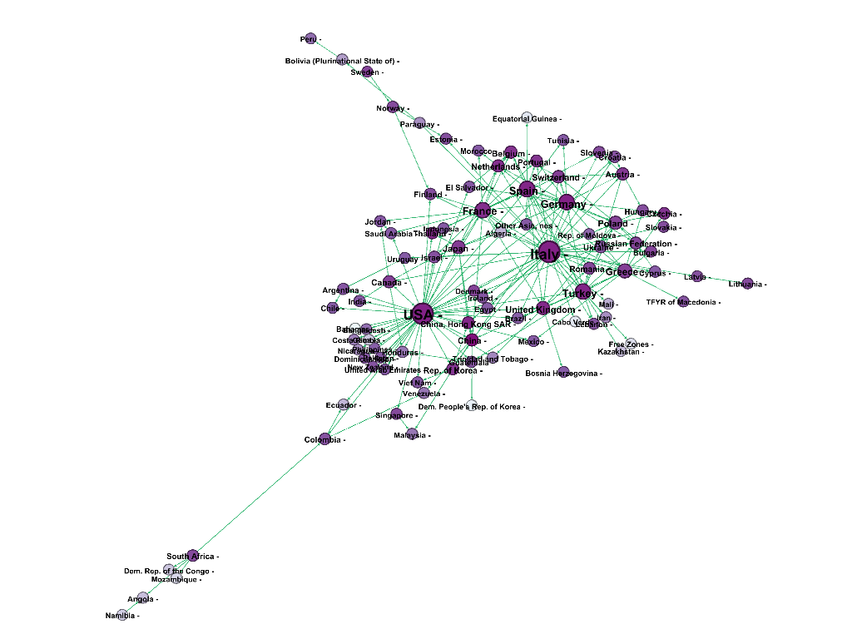
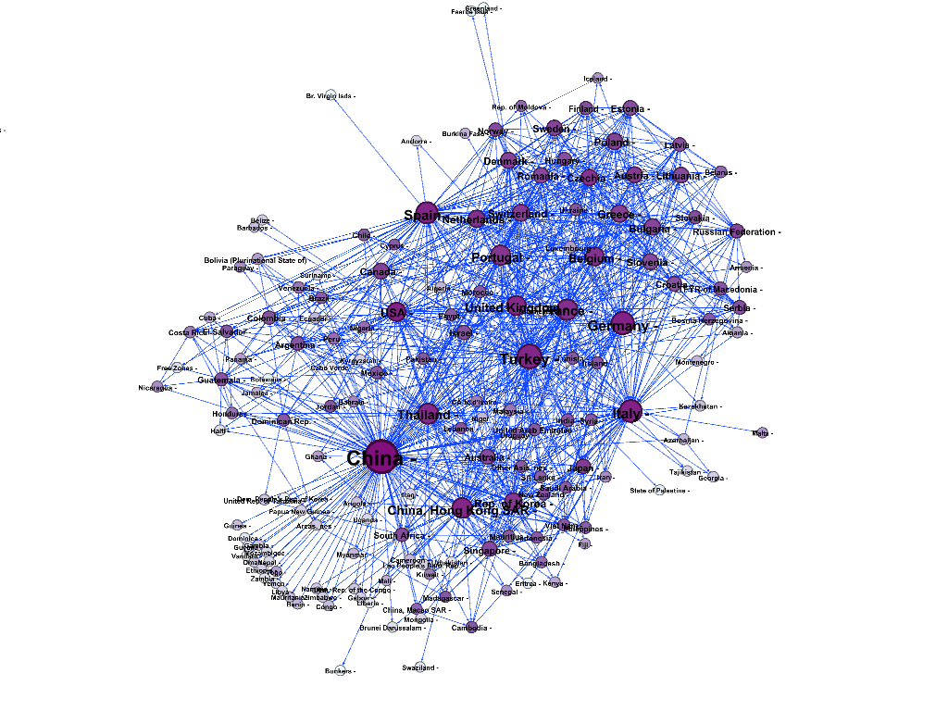
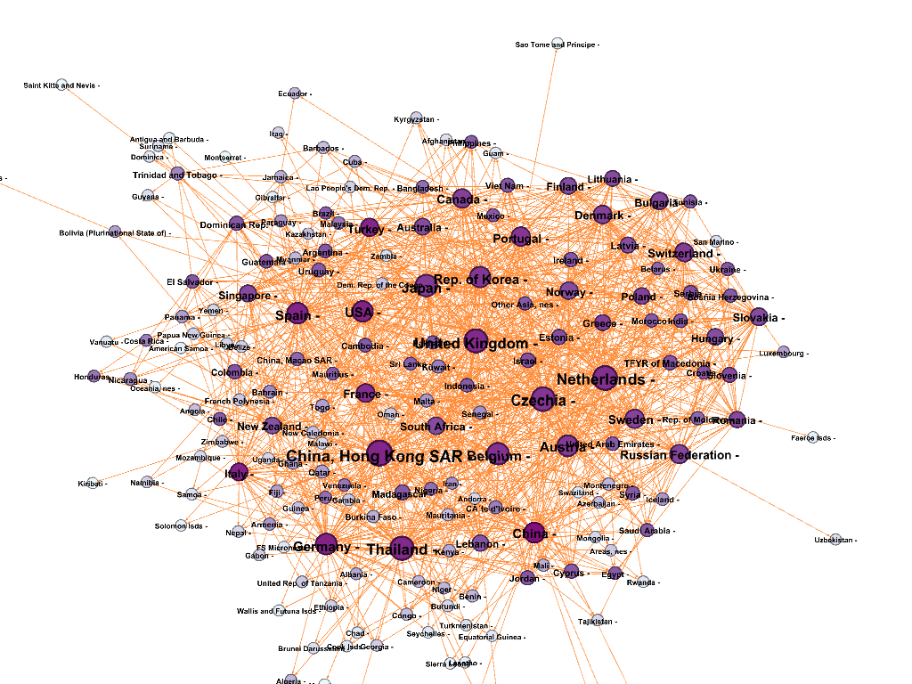
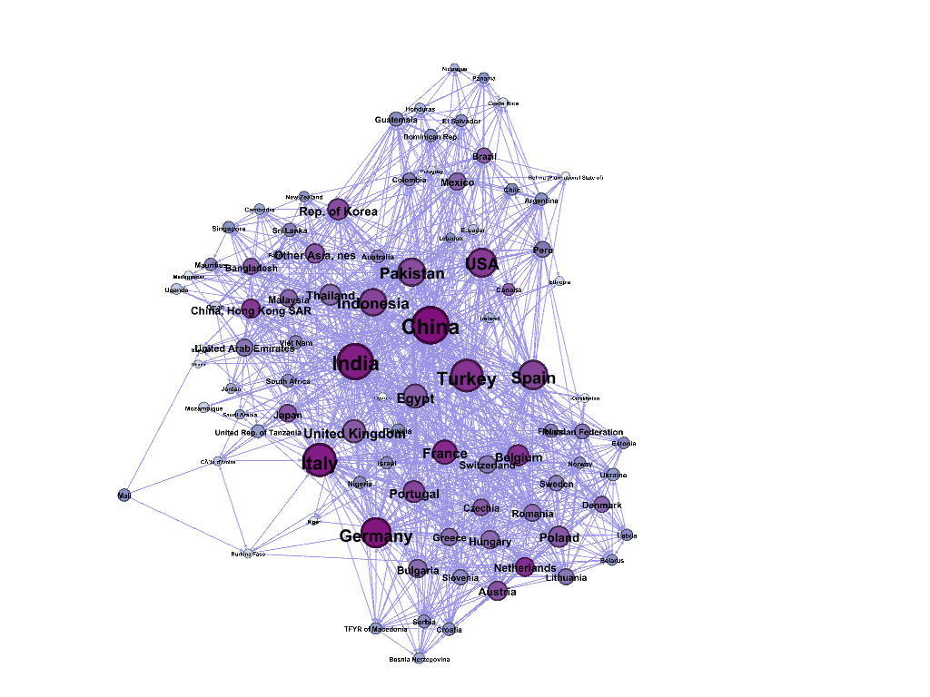
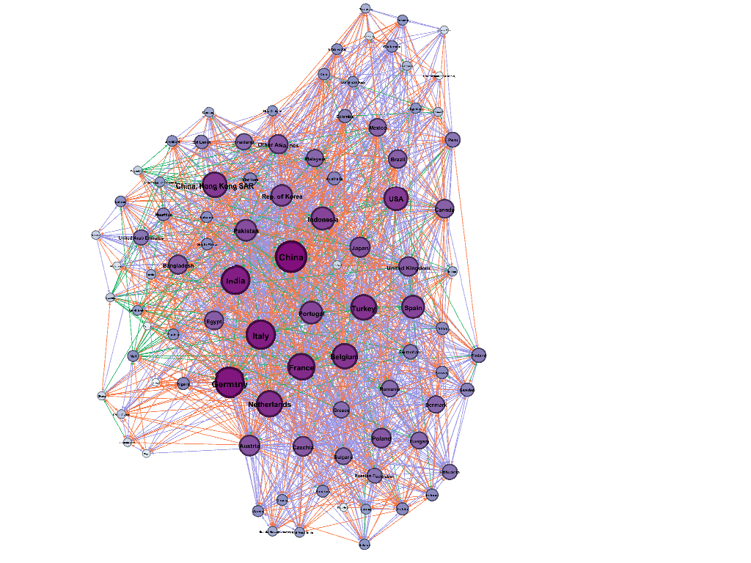
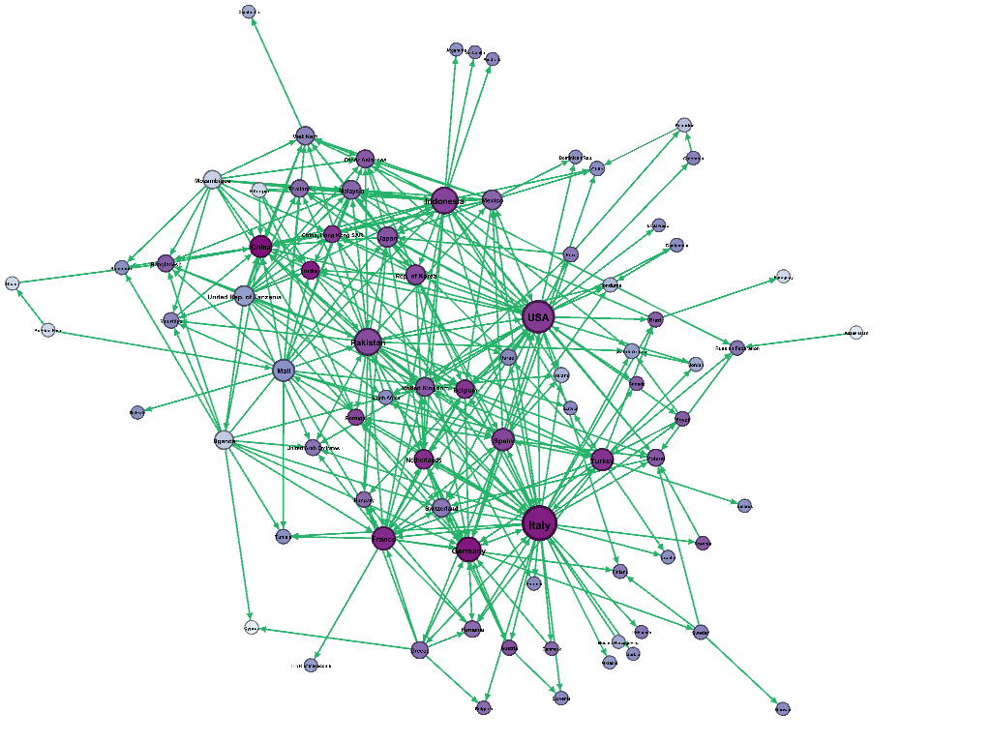
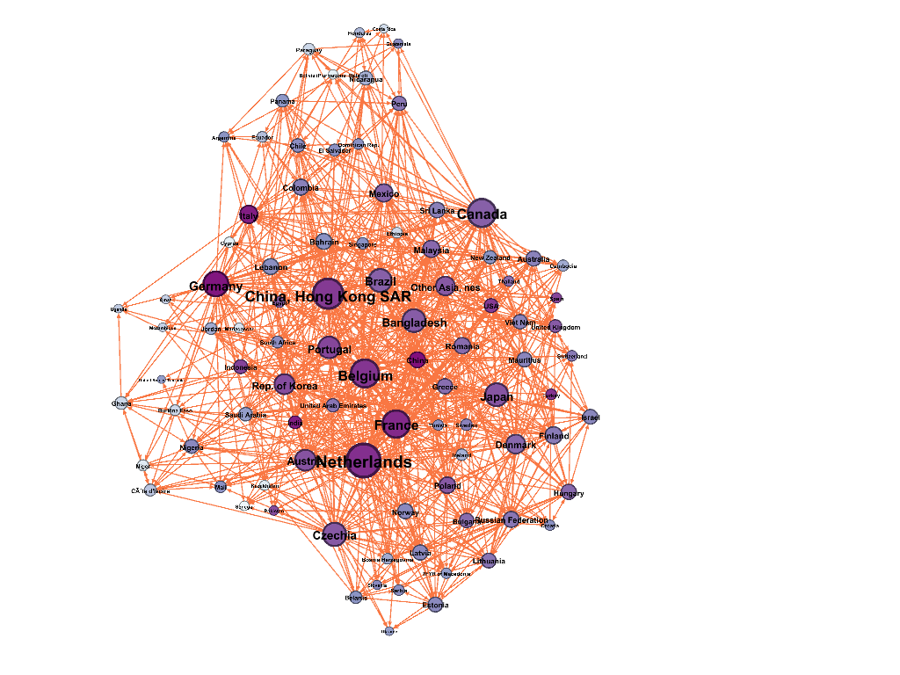
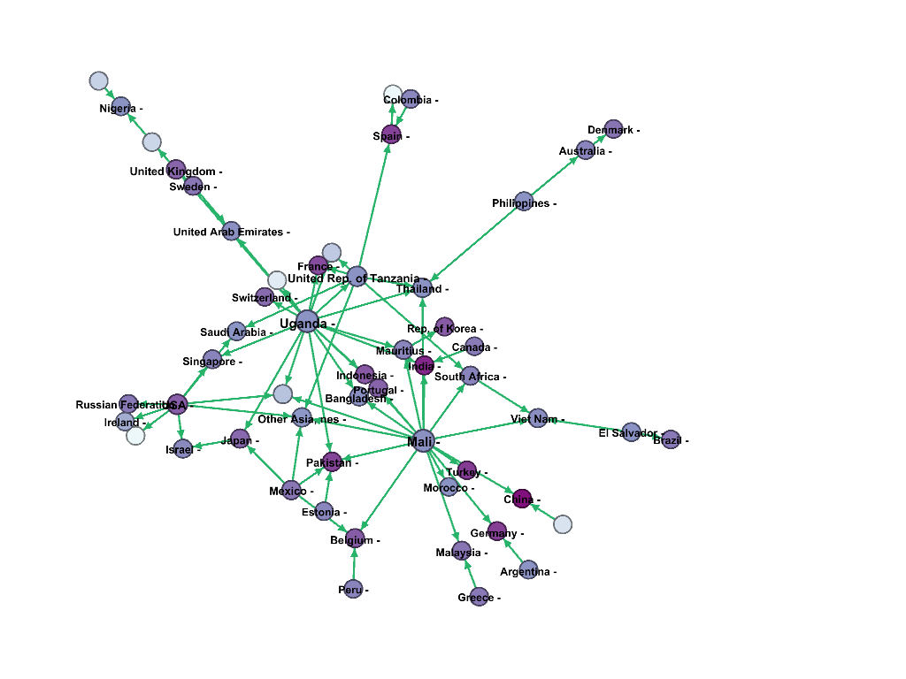
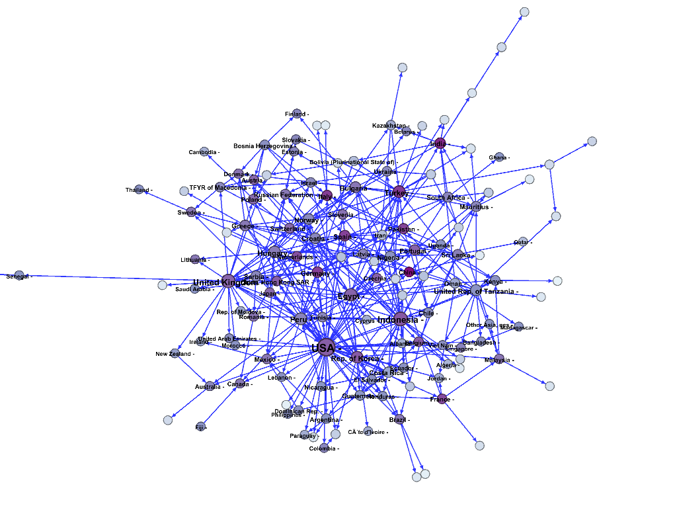
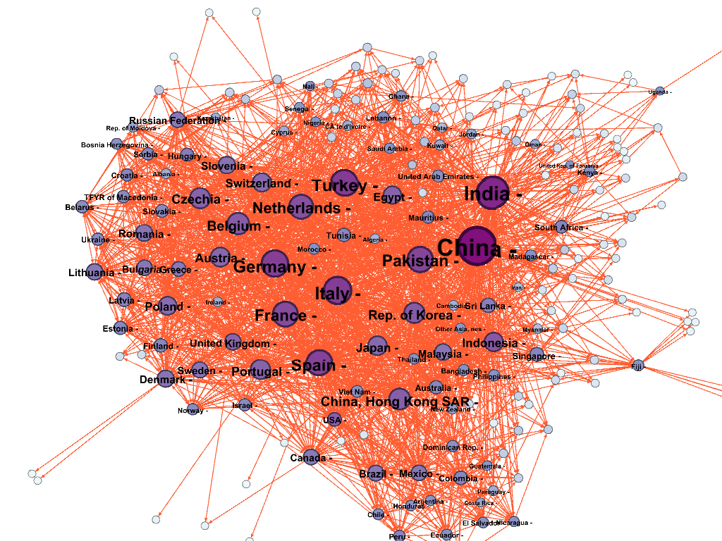
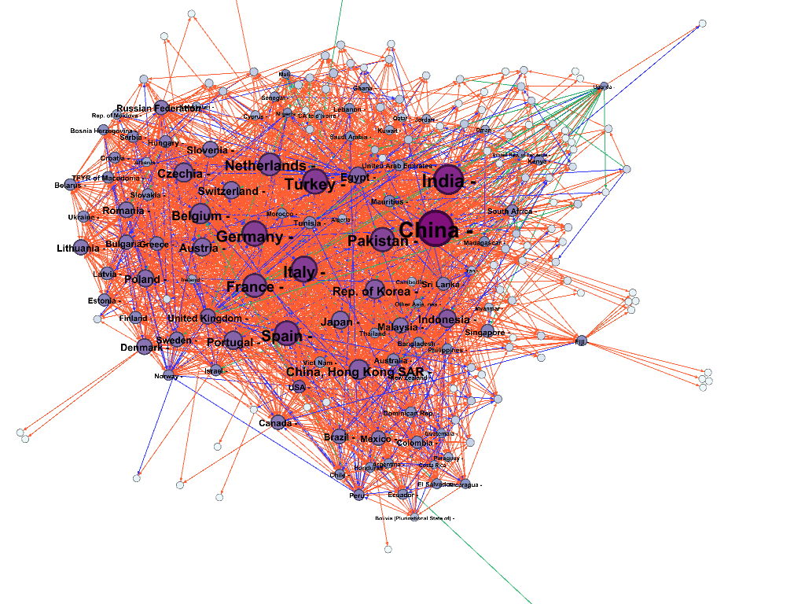
2007
Combed and carded Cotton Network
Yarn Cotton Network
Fabric Cotton Network
Cotton Network
2012
2017

Slide 5
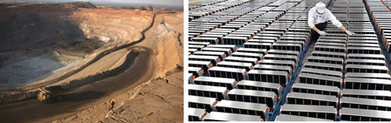
Cobalt supply chain - two views
Supply Chain
Fraser et al., (2020)
Supply Network
van den Brink et al., (2020)

Slide 6
Can digital technologies help?

Slide 7
Blockchain technology for supply chain traceability

Slide 8
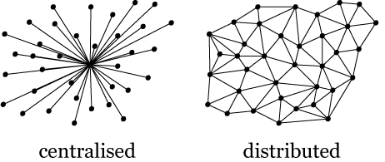
What is Blockchain Technology?
Blockchain ≠ Bitcoin
Blockchain is a combination of technologies comprising a digital chain of records that are time-stamped, uniquely identified using cryptography, and stored in a chronological order on a distributed ledger. Each block refer to the block that precedes it in the network and blocks are validated based on the consensus mechanism of the network to establish agreement on the ledger history.
Blockchain networks can be public/permissionless, private/permissioned or Hybrid, allowing different access, read and write rights to the network participants
Block n-1
Block n
Block n+1
Block (n-2) Hash
Block (n-1) Hash
Block (n) Hash
…
Timestamp & other info
Timestamp & other info
Timestamp & other info
…
Current Block Hash
Current Block Hash
Current Block Hash
Transactions
Transactions
Transactions

Slide 9
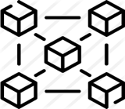
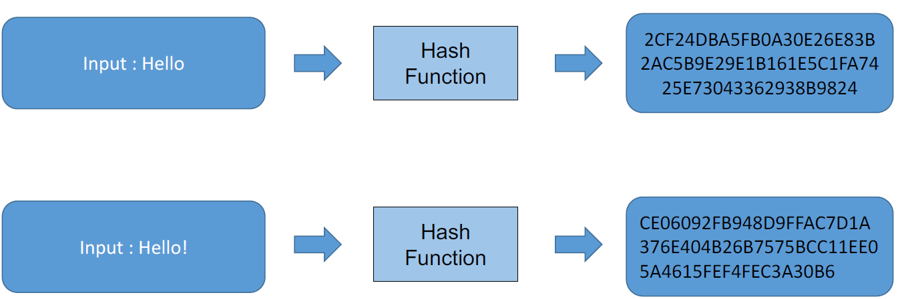
Blockchain Technology Core Characteristics
Digital Technology, Transactions can include any type of data
Digital Assets
Distributed Ledger
Cryptography
Consensus mechanisms
Timestamped Transactions
Centralised ledger - owned/controlled by one participant in a network
Blockchain Core Characteristics
No central authority. Data is distributed and broadcasted to all the nodes in the network in real time
All participants have to agree on single truth, i.e., the current status of the ledger
Each Transaction is timestamped, and blocks are linked in a chronological order
Use of complex mathematical and computational algorithms to create unique digital signatures for the blocks based on its data (i.e., hash)

Slide 10
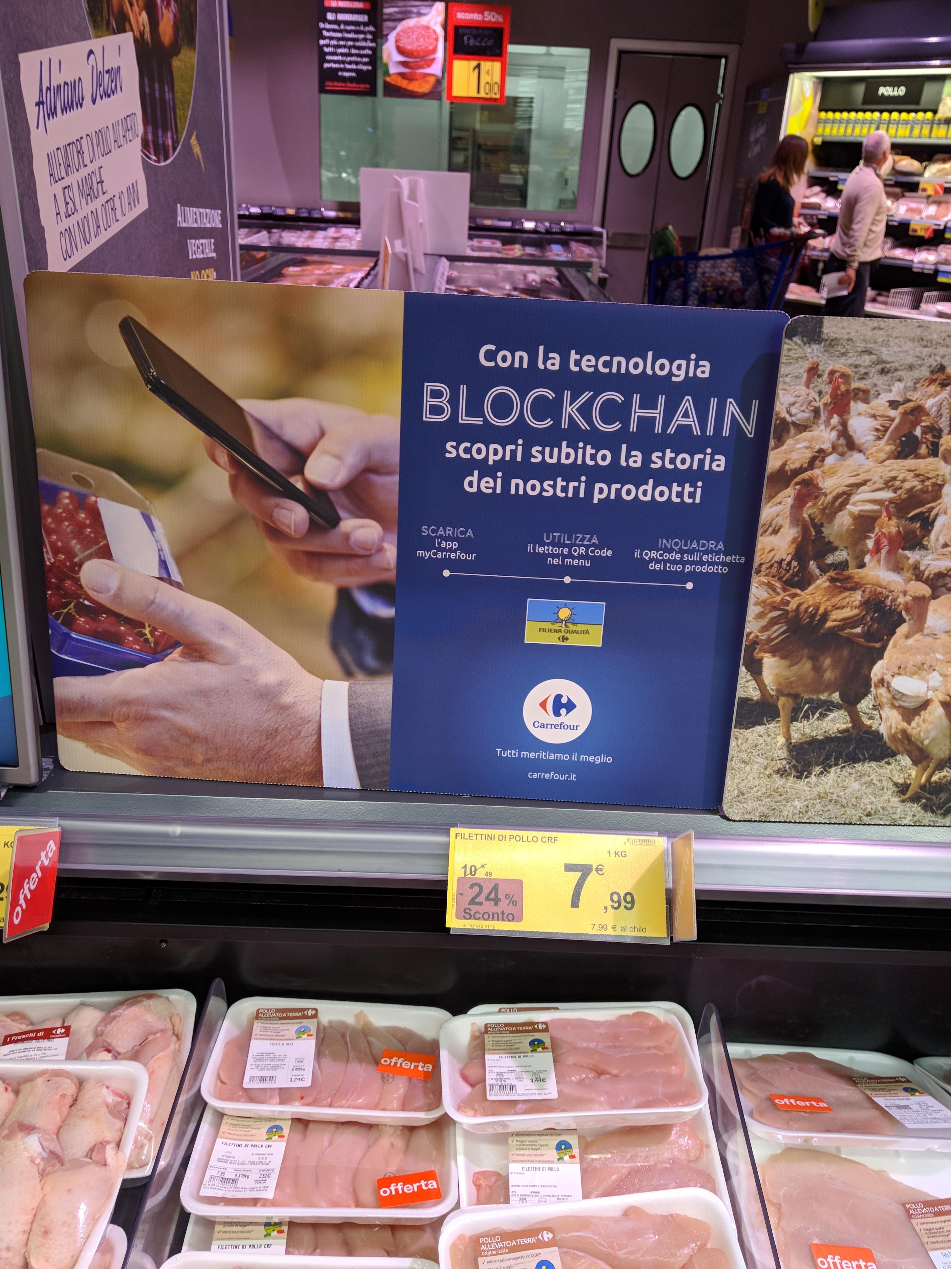
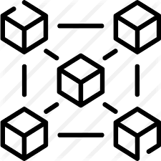

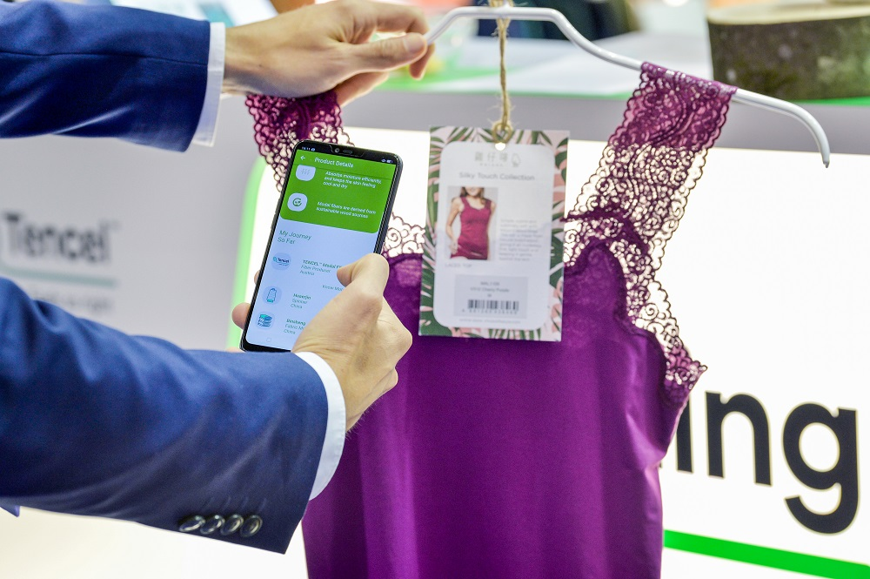
Blockchain in the Supply Chain – Why?
Blockchain provides an immutable digital ledger promising a ‘single source of truth’ for a supply chain
May contain information on supply chain products, processes, operations, and transactions
Each block is time-stamped, can be traced and may contain any type of data, e.g., geo-location information
Many potential supply chain applications
Provenance - where has this product come from?
Traceability – where has it been?
Authenticity – is this a genuine product?
Sustainability – has this product been produced in a sustainable way?
+ many other claimed applications (e.g. smart contracts)

Slide 11
Blockchain in the Supply Chain – Why?
What can blockchain do to supply chain management?
Globalization and Complexity
Visibility
Sustainability
Counterfeiting
Risks and Disruptions
Quality
… and more
Blockchain Capabilities
Blockchain Technology
Transparency
Traceability
Security
Immutability
Reliability
Process Integrity

Slide 12

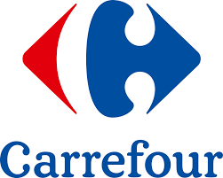

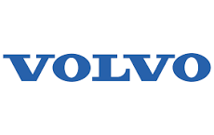
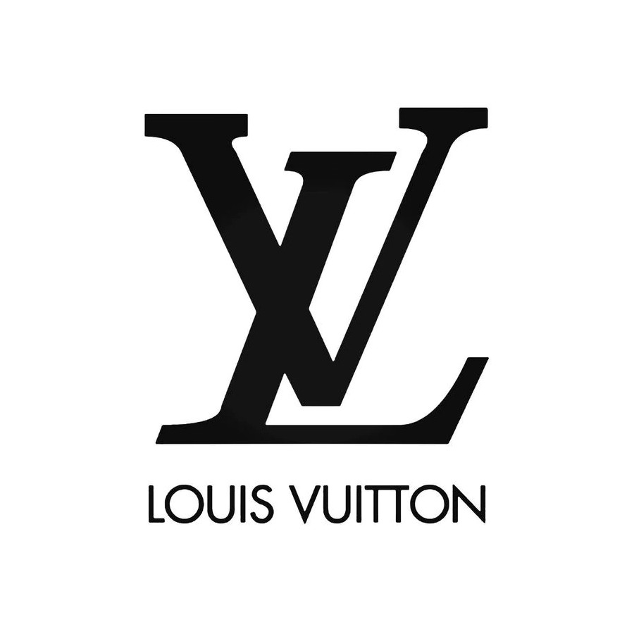

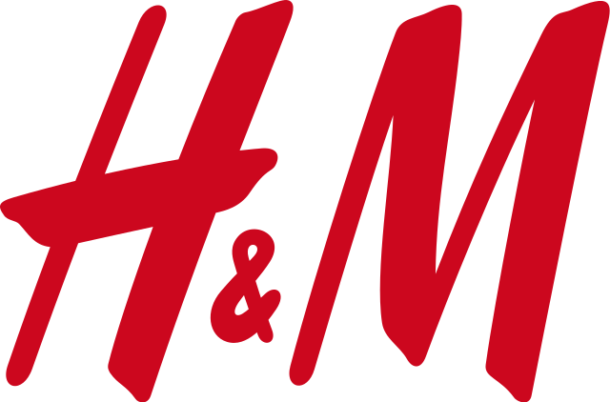

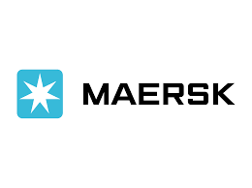

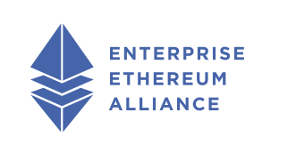






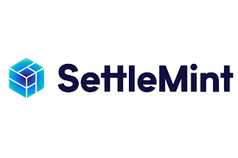


Blockchain in Practice
Increasing number of organizations are implementing blockchain projects in the different sectors
Increasing number of blockchain consortia focusing on business and supply chain applications
Ahmed and MacCarthy (2022). Blockchain technology in the supply chain: learning from emerging ecosystems and industry consortia
Increasing number of blockchain providers

Slide 13
Blockchain Supply Chain Applications - Case Studies

Slide 14

Textile Supply Chain
Ahmed, W.A. and MacCarthy, B.L., 2021. Blockchain-enabled supply chain traceability in the textile and apparel supply chain: A case study of the fiber producer, Lenzing. Sustainability, 13(19), p.10496.

Slide 15
Lenzing AG – Manmade Cellulose Fiber Producer
A world leading manmade cellulose fiber producer (made from wood).
Three types of fibers: Viscose, Modal, and Lyocell.
Three downstream applications, i.e., Textile, non-woven and industrial applications.
Highly sustainable manufacturing processes (i.e., use of Refibra technology that use 30% recycled cotton in fiber production).
Ahmed and MacCarthy (2021)

Slide 16
Lenzing Group Products Offering
1. TENCIL Fibers
Lyocell fibers
Mainly for Textile
2. Eco Vero Fibers
Viscose fibers.
50% less emissions and water impact.
3. VEOCEL Fibers
Lyocell fibers.
Ideally used for sanitary and baby care products, wipes, facial sheets, etc.
4. LENZING Fibers
Use of REFIBRA technology – recycling cotton waste and own lyocell fibers.
Partners: ASOS, Levi’s, H&M, Guess, TED Baker, etc.
Certified renewable wood sources.
Partners: J.Crew, MONSOON, ESPRIT, etc.
Great water absorption and smoothness.
Lyocell Fibers.
Hi-Tech fibers for industry and agriculture solutions.
Provides strong fibers ideal for industrial uniforms.
Mainly for nonwoven applications.
Provides sustainable packaging solutions.

Slide 17
Lenzing AG – Manmade Cellulose Fiber Producer
 | Lyocell | Modal | Viscose
Production Volume Capacity | 263,000 T p.a. | 60% of 284,000 T p.a. (around 170,400 T p.a.) | 785,000 T p.a.
Market Share (Approx at the time of the study) | 86% | 50%–60% | 14%
Product Innovativeness and Complexity | High | Medium | Low
Product Value | High | Medium | Low
Environmental Impact | Low | Low—Lenzing-specific High—General in the textile market | Medium—Lenzing-specific High—General in the textile market
Applications | Textile, Non-woven, and Industrial | Textile | Textile, nonwoven
Top Challenges | Product fraud Consumer awareness and education Capacity constraints Inter-fiber substitution (cotton, polyester, polyamide, etc.) | Sustainability Capacity constraints Inter-fiber substitution | Sustainability Market competition (costs, volume, etc.)

Slide 18
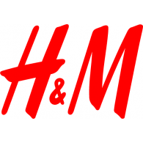




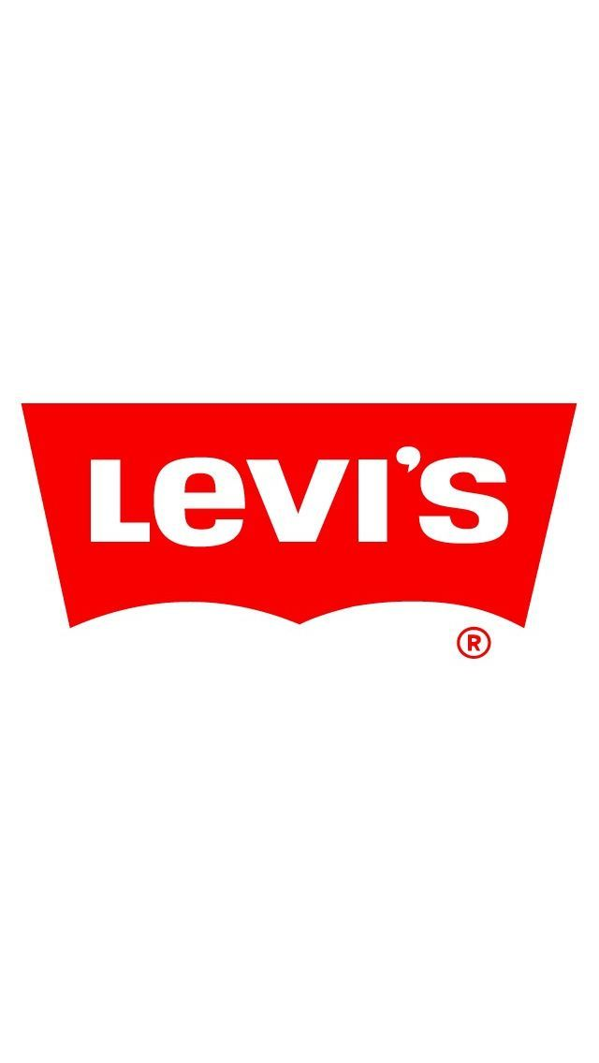


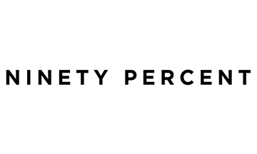


Lenzing – Textile Supply Network Configuration
Viscose & Modal Production
Austria
Spinners
Fabric producer (276)
Processing Facilities (2046)
Garment Producer (1900)
Lyocell Production
Austria
Big Brands
Complex and Large Supply networks
Low % of Lenzing fibre
Keen on achieving sustainability
Harder to implement traceability solution
Pulp Production
Austria & Czech Republic
Spinners (only 9% of total material used)
Fabric producer
Processing Facilities
Garment Producer
(Approx 960)
Viscose Production
Indonesia
Purchased Pulp
Supplier Production
Viscose Production
China
Spinners
(10,500 MT pa)
439 factories
Lyocell Production
USA
Lyocell Production
UK
Relatively smaller brands
Small-Medium Supply networks
Higher % of Lenzing fibre
Based on sustainable materials (e.g. 90% , thought clothing)
Easier to implement traceability solution
Others
Spinners
Fabric producer
Processing Facilities
Garment Producer
(3)
Ahmed and MacCarthy (2021)

Slide 19





Main motivations for blockchain adoption
Lenzing TENCIL fibers
Textile Genesis
Chicks
Fiber traceability
Verify the use of sustainable fibers
Misleading information
Educate the customers about Lenzing sustainable fibers.
Supply chain visibility and mapping
Knowledge of material flows
Ensure product authenticity
Fight counterfeiting
Lack of traceability
Lack of visibility
Ahmed and MacCarthy (2021)

Slide 20

Textile Genesis Platform – Key Features
Private Permissioned Blockchain Network
Provides fibre-to-retail transparency with the use of blockchain technology and Fiber coins.
Fibre coins are only created at the fibre sources and transferred across the supply chain.
1 TG Fibre coin = 1 kg Lenzing fibre.
Fibre coins are linked to volume in invoices, purchase orders and shipment references.
1000 Fibre Coins
S1
500 F1
Fibre Coins
G1
350 G1
250 G2
Fibre Coins
Creating Fibre Coins
800
Fibre Coins
F1
500 Fibre Coins
S2
100 G1
Fibre Coins
200 F1
200 S2
Fibre Coins
G2
50 G2
Fibre Coins
Fibre Producer
Spinner
Fabric Producer
Garment Maker
Brand Retailer

Slide 21
Lenzing Blockchain Pilot
Lenzing TENCIL fibers
Textile Genesis
Chicks
Lenzing partnered with blockchain provider Textile Genesis and Chinese brand Chicks for piloting blockchain technology.
Textile Genesis (TG) developed blockchain solution that enables fiber-to-retail traceability with the use of Fibercoins.
Lenzing uses embedded chemical material to physically identify its fiber.
Chicks supply chain was simple and less complex supply chain which supported the success of the pilot.
After the success of the pilot, Lenzing has conducted several pilots in more complex supply chains (e.g., with H&M)
Ahmed and MacCarthy (2021)

Slide 22
Textile Genesis Platform – Blockchain Network Characteristics
Type of Blockchain Network
Private Permissioned Blockchain Network
Deployment of smart contracts
To resemble business logic (used for validating certificates, reading PDF files, and calculating inventory).
Network Governance
Technology Regulations
Technology Standards
Governed by the blockchain provider.
Compliance to GDPR
Use of GS1 global standards
Auditing is conducted for triggered transactions.

Slide 23
Textile Genesis Platform – Key features
Fibre Coins
Fibre Coins
Fibre Coins
Fibre Coins
Fibre Coins
Fibre Coins
Fibre Coins
Fibre Coins
Fibre Coins
Fibre Producer
Spinner
Fabric Producer
Garment Maker
Brand Retailer
S1 Received 6000 coins of fibre
S1 Inventory 2500 yarn
TG Platform also capture yarn ID, Blend ratio, waste %
Assumption: Yarn ID- 1, Blend ratio 40% of Lenzing fiber, Average waste 3%.
S1 sent 10 Ton of yarn to F1:
No of fiber coins that would be transferred = 10,000*0.4= 4000 fibercoins
Fibercoin production balance= 6000*0.97 = 5820
S1 new inventory balance = 5820+2500-4000=4320 fibercoins
Example
Fibre producer produced 10 ton of fibre and created 10,000 fibercoins
6000 transferred to S1
4000 transferred to S2

Slide 24
Textile Genesis Platform – Example of Platform Information
 | Provided Information | Received Information
Fibre Producer | All outgoing transactions (shipment ref, PO, invoice, customer name). Fibre Type Volume | All supply chain partners’ name, location, and certifications. Audits result across the supply chain. Fibre coins inventory across the supply chain.
Spinner | Incoming and Outgoing Transactions (shipment ref, PO, invoice, customer/supplier name). Yarn ID. Blend Ratio. Volume. | Incoming transactions from their suppliers. Their audit information.
Fabric Maker | Incoming and Outgoing Transactions (shipment ref, PO, invoice, customer/supplier name). Fabric ID. Blend Ratio. Volume and Dimensions. | Incoming transactions from their suppliers. Their audit information.
Garment Maker | Incoming and Outgoing Transactions (shipment ref, PO, invoice, customer/supplier name). Garment ID. Blend Ratio. Volume and Dimensions. | Incoming transactions from their suppliers. Their audit information.
Brand Retailer | All Incoming Transactions (shipment ref, PO, invoice, supplier name). Garment ID. Blend Ratio. Volume and Dimensions. | All network members’ name, location, and certifications. Materials flows in the upstream supply chain. Audits result across the supply chain.
Ahmed and MacCarthy (2021)

Slide 25
Key Capabilities of TG Platform
Provides a robust and unified platform for all Lenzing SC partners to manage their inventory and ordering and shipment transactions.
Ensure Fibre Authenticity: With the use of fibre coins, brand retailers will be assigned fibre coins for every garment product that include Lenzing fibres. Without the possession of fibre coins, brand retailers cannot claim that they provide Lenzing sustainable fibres.
Provide Lenzing and brand retailers with knowledge about their supply network.
Provide Lenzing with Inventory Information across the supply chain.
Provide an integrated platform capturing the required certifications across the supply chain.

Slide 26
Textile Genesis Meeting Lenzing Business Needs
1. Ensure Product Authenticity
- End brands using co-branded swing tickets.
-Claiming the use of sustainable fibers
2. Fibre Supply Chain Traceability and Visibility
-Supply chain mapping.
- Materials Flows
Partially Addressed (No access to material flows).
Fully Addressed
3. Customers Education and Awareness about sustainable fibres
-Educate the customers about Lenzing sustainable fibres.
Out of Scope
Any other limitations?
Ahmed and MacCarthy (2021)

Slide 27
Key Limitations of TG Platform
Visibility and traceability: Lenzing get to know the location of its fibre across the supply chain. However, the traceability solution is partial with key limitations including:
Lenzing doesn’t have visibility to the material flows downstream its supply chain. Lenzing only knows the location of the different SC partners and their fibre coin inventory.
The platform does not enable the traceability of a particular product batch across the supply chain.
Inventory and waste calculation: TG platform automatically calculates the expected waste % generated at each stage of the supply chain.

Slide 28
Key Limitations of TG Platform
Inventory Information:
TG Platform provides real-time information about inventory balances across the supply chain. The platform also considered and calculates the waste generated at each stage in the supply chain.
TG platform automatically calculates the expected waste % generated at each stage of the supply chain.
The expected waste is deducted from the amount of fibre coins that can be transferred.
Waste Information:
Although the value of expected waste can be a close approximation to the actual value, over time the difference will build up and may result in inaccurate balances across the supply chain. This will risk the credibility of the whole solution.
Accurate waste calculation at each stage based on real values.

Slide 29


Automotive Leather Supply Chain
JAGUAR LAND ROVER AUTOMOTIVE PLC
ANNUAL REPORT 2021/22

Slide 30
Automotive OEM Global Leather Supply Chain Map – The Traceability Challenge
Farms
Tier 10,9, 8, 7, 6, 5
Leather Production
Tier 5,4, 3
Interior Assemblers
Tier 1
Leather Sources
Cut and Trim
Farms
Argentina
Abattoirs
Argentina
Sub Tannery
Argentina
Directed Supply Chain – OEM nominate leather producers
Cutting/ Sewing/ Wrapping
Cutting/ Sewing/ Wrapping
Seat Manufacturer & Head Rest
Leather Supplier 1
UK
Farms
Europe
Abattoirs
Europe
Cutting/ Sewing/ Wrapping
OEM
Farms
Europe /North America
Abattoirs
Europe /North America
Sub Tannery
Seat Manufacturer
Cutting/ Sewing/ Wrapping
Cutting/ Sewing/ Wrapping
Leather Supplier 2
Italy
Cutting/ Sewing/ Wrapping
Farms
Brazil
Abattoirs
Brazil
Sup-tanneries
Brazil
Head Liner Supply Chain
Cutting/ Sewing/ Wrapping
Farms
Brazil
Abattoirs
Brazil
Sub Tannery (JBS )
Brazil
Leather Supplier 3
Germany/ Hungary
Arm Rest Supply Chain
Door Casing Supply Chain
Farms
World Wide
Abattoirs
Agents
Leather suppliers
China/ Solvakia
Cutting/ Sewing/ Wrapping
Cutting/ Sewing/ Wrapping
IP & C Supply Chain
Information Flow
Material Flow
Ahmed and MacCarthy (2023)

Slide 31




Main motivations for blockchain adoption
Automotive OEM
Technology Provider
Leather Tannery
Customer Service
Identifying leather provenance
Lack of visibility
Identifying the provenance of leather used in the OEM vehicles.
Compliance and sustainability
SC visibility and optimisation.
Provide customers with improved options.
Ensure leather compliance and sustainability.
Ahmed and MacCarthy (2023)

Slide 32
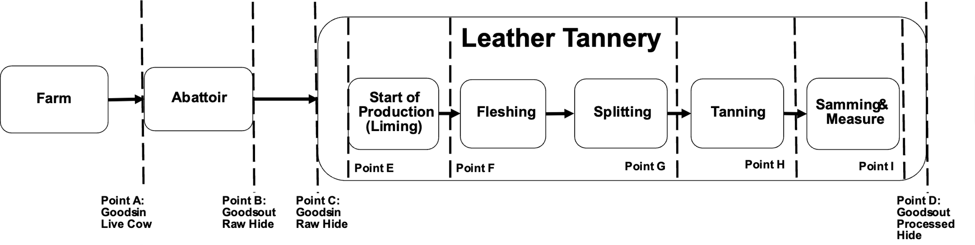
Global Automotive Leather Supply – Pilot Project
Engage the required SC partners
Map the supply chain
Identify data capture points
Define product identification methods and linkage between the different data capture points
Identify data requirements at each data capture point
Identify data upload methods at the different data capture points
Configure the blockchain platform
Ahmed and MacCarthy (2023)

Slide 33
Global Automotive Leather Supply – Pilot Project
Data Capture Point | Data Capture Identifier | Captured Information (Attributes)
1. Abattoir – Goods-in (Point A) | CTS Passport Number | Farms CTS Data including: - Producer code - Location (Area code) - Breed - Date of birth - Age - Origin - Number of movements - CO₂ emissions
2. Abattoir – Goods-out (Point B) | CTS Passport Number Slaughter Tag number | - Kill date - Kill number - Net weight - Grade - Transport ID (CO₂ emissions) -Energy use in process (CO₂ emissions)
3. Tannery – Goods-in (Point C) | CTS Passport Number Slaughter Tag number | - Date - Pack Number Market - Weight Range - Type - Origin - Preservation Method (Iced, salted, etc.) - Contracting tanning (Yes/No)
4. Tannery – Liming, Fleshing, splitting, and tanning processes (Point E, F, G & H) | Tannery Ear Tag number | - Date - Pack Number Market - Weight Range - Type - Origin - Preservation Method (Iced, salted, etc.) - Contracting tanning (Yes/No)
5. Tannery – Samming and measure (Point I) | Laser Engraving with the ear tag number | - Size (Square meter) - Grade - Weight
6. Tannery – Goods-out (Point D) | Laser engraved ID | - Transport ID (CO₂ emissions) - Customer ID - Energy use in processes (CO₂ emissions)
Ahmed and MacCarthy (2023)

Slide 34
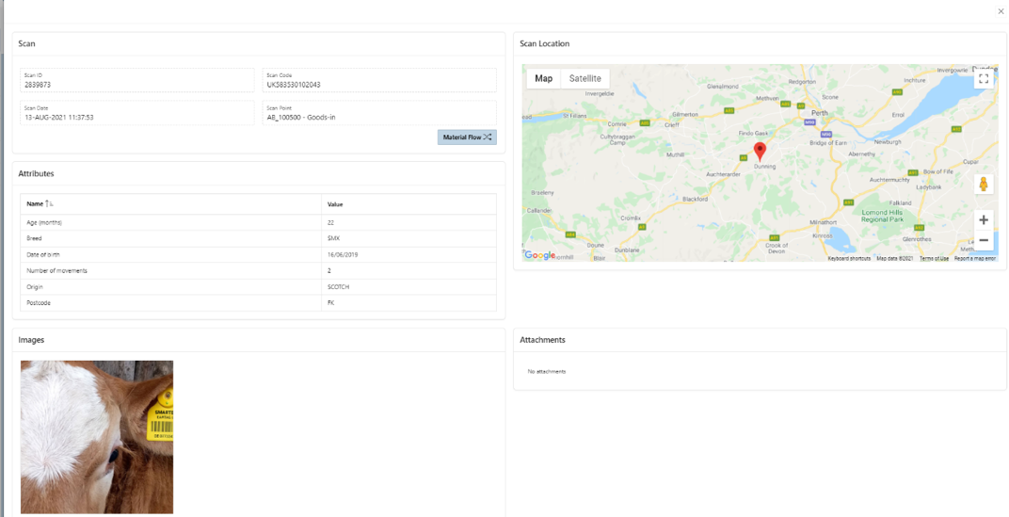
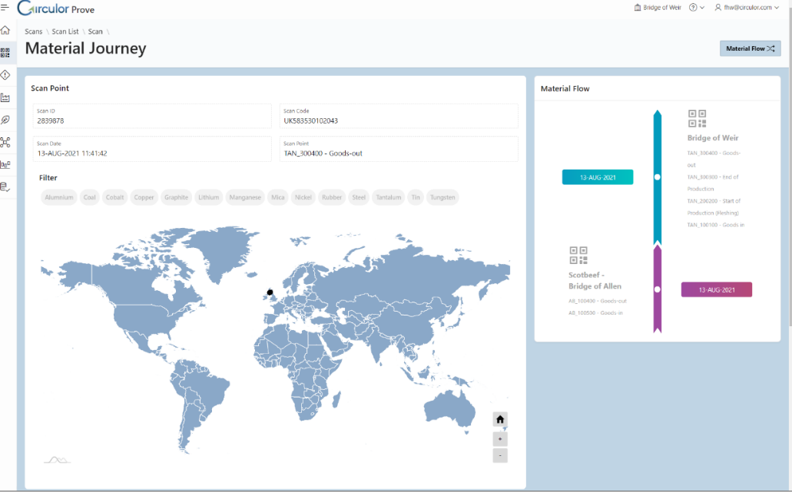
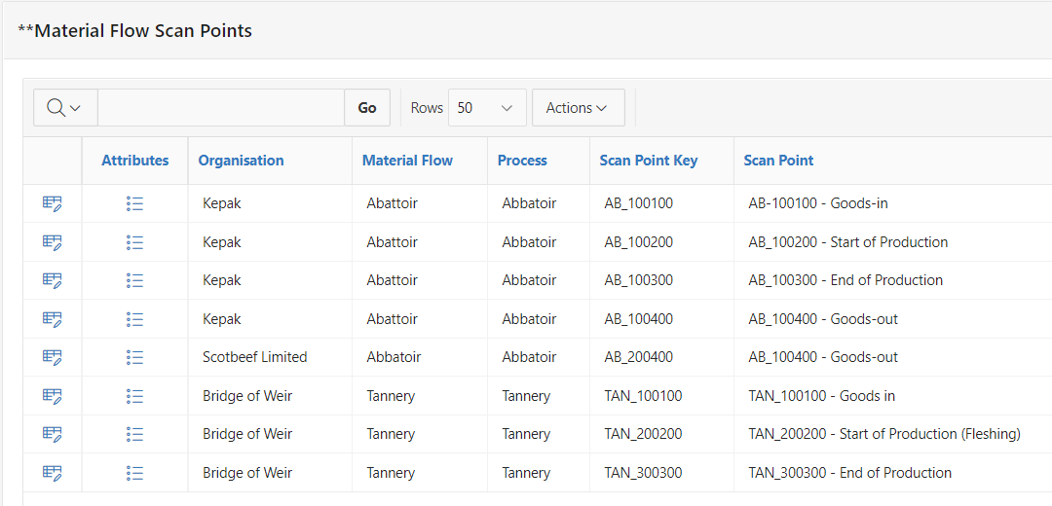
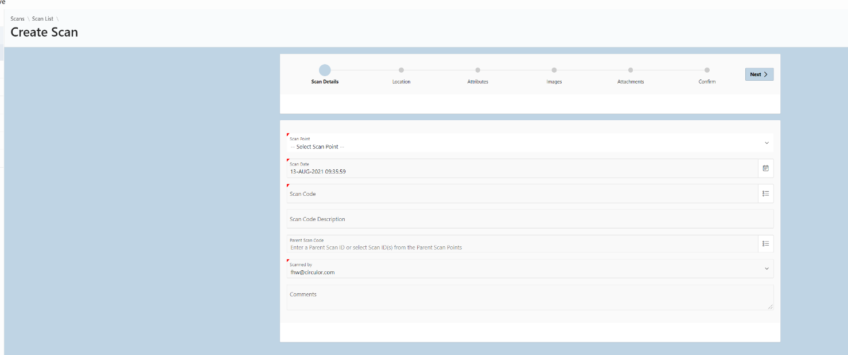
Global Automotive Leather Supply – Pilot Project
Leather Tannery
Abattoirs and Tannery Names
Abattoir

Slide 35
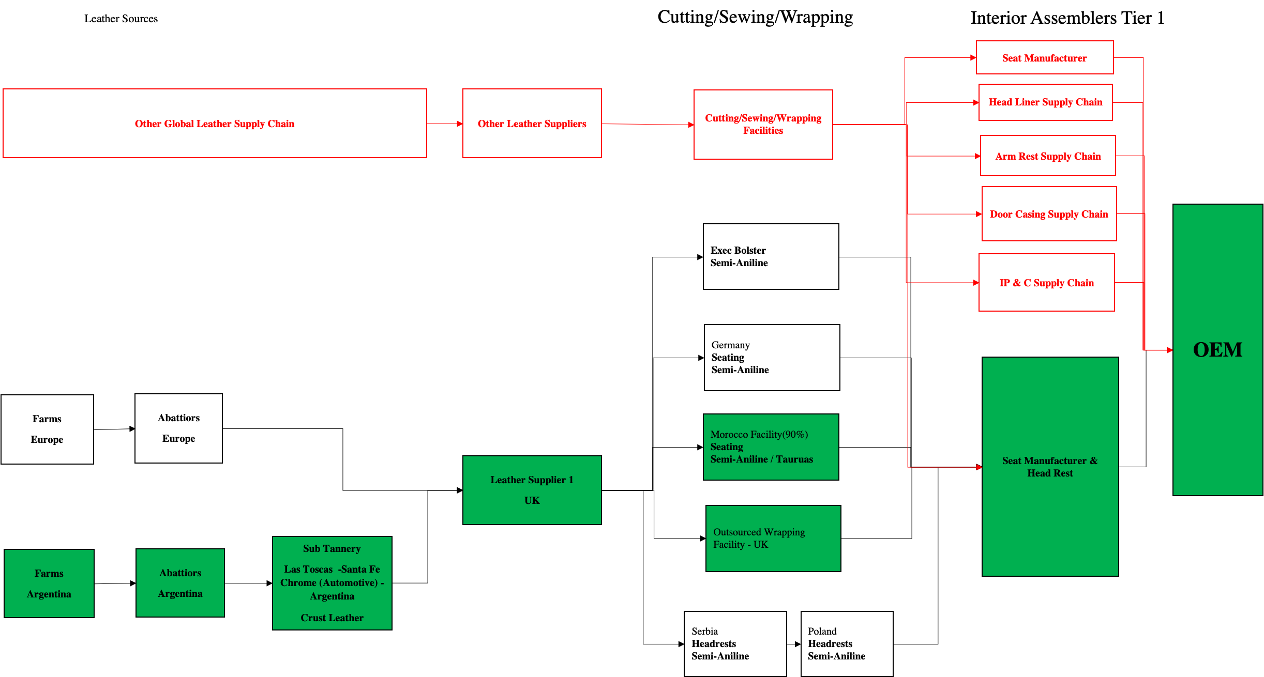
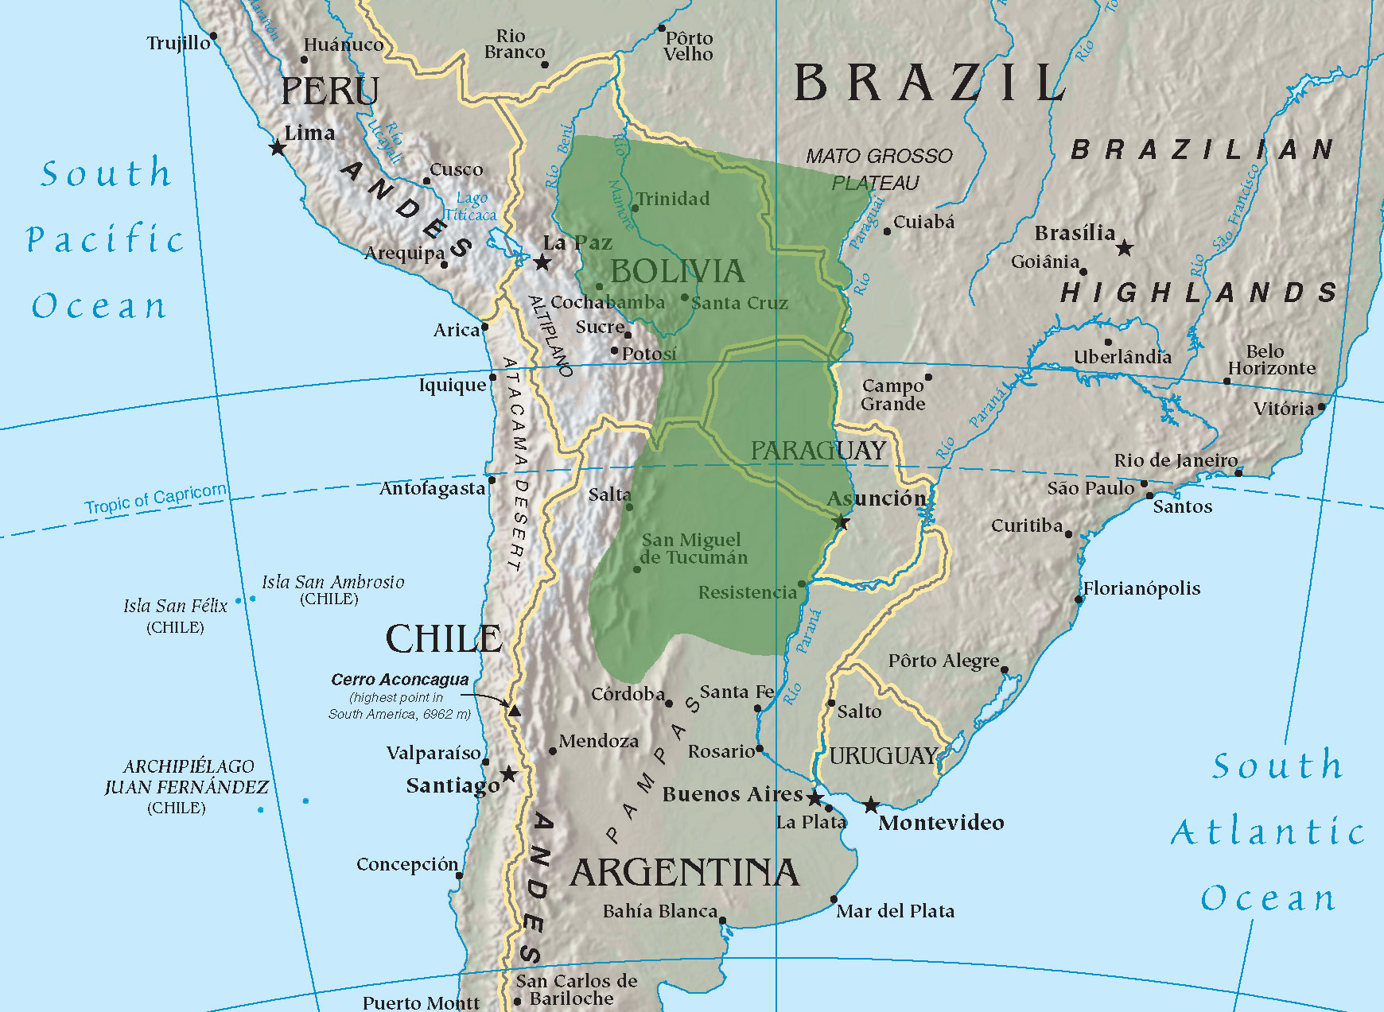
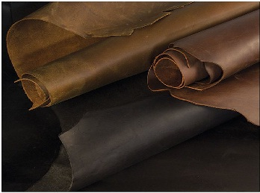
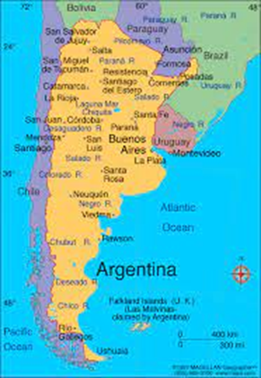
Global Automotive Leather Supply – Argentinian Case
Limited / variable regulation and trusted data upstream eg no cattle passport in South America
Could adopt ‘Trust Points’ from Tannery (ie aggregators of upstream data).... But relies on Tannery verifying and maintaining upstream provenance
Direction of travel towards improved traceability driven by export driven pressure
Would require specific technologies and Trust Point focus on key risks eg Deforestation / Animal Welfare
Interior Assemblers
Leather Sources
Cutting / Sewing / Wrapping
Trust Point
Risks
Gran Chaco Deforestation
Animal welfare
Trust Point

Slide 36
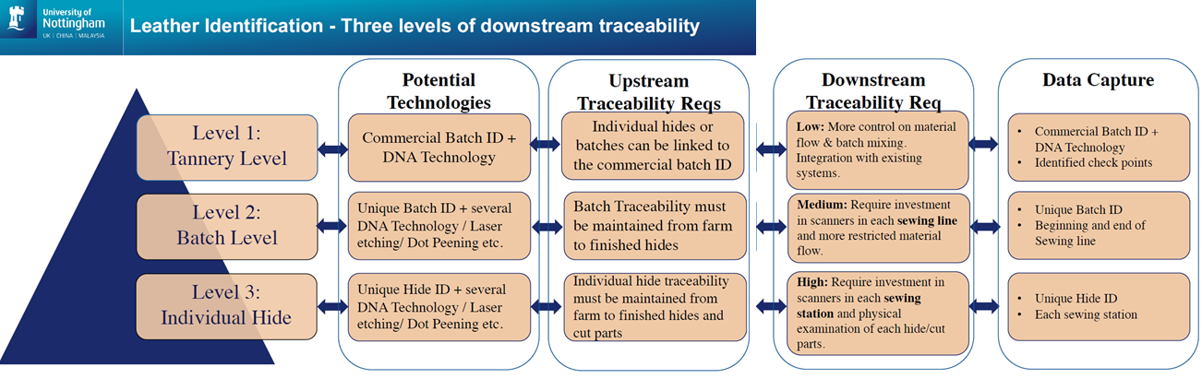
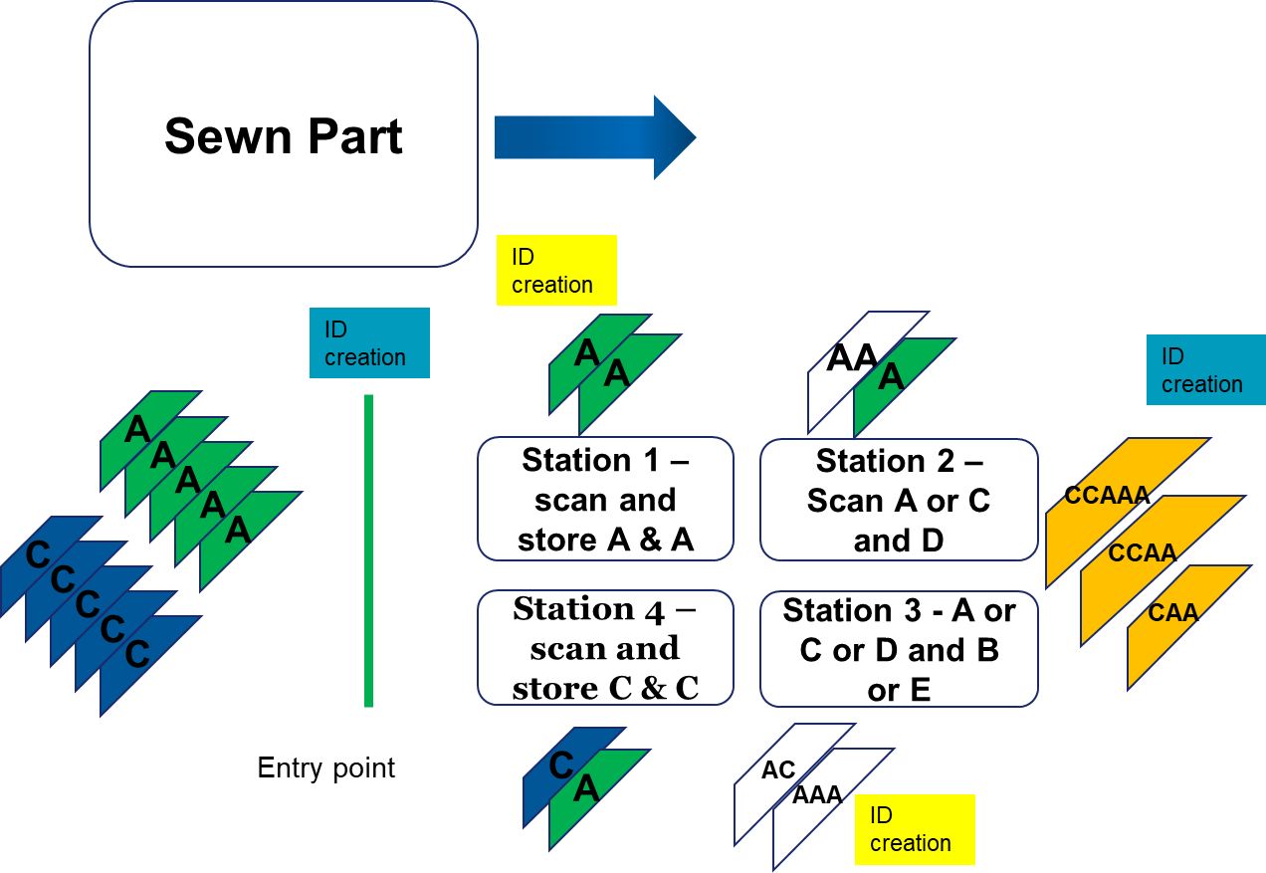

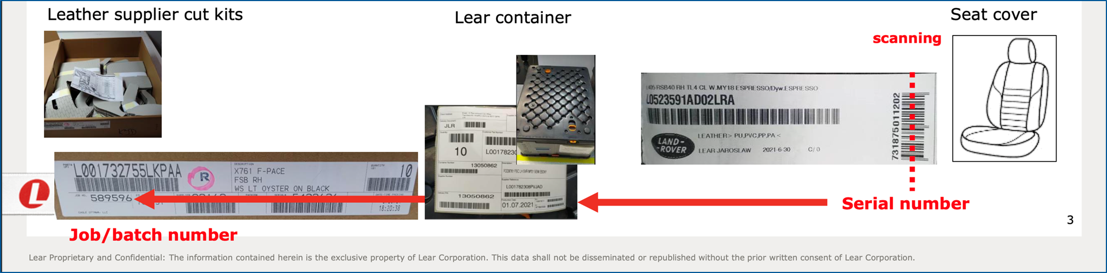
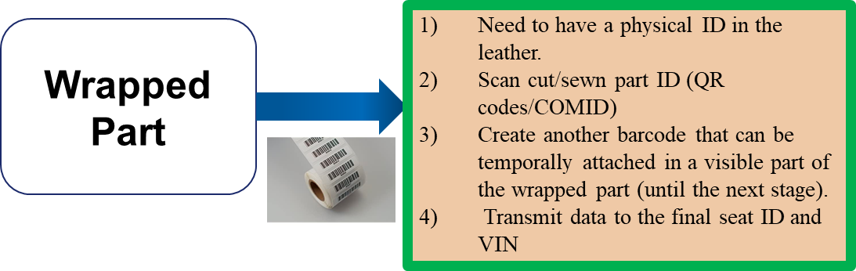
Three levels of Downstream Traceability – What is feasible?
1. Tannery level traceability is feasible with some further controls
2. Batch level traceability requires significant control but is feasible and may be beneficial
3.Hide level is infeasible - technologically and costs
Mixing of parts downstream significantly increases complexity for piece part tracking
?

Slide 37
Noted in JLR’s Annual Report – May 2022
HARNESSING BLOCKCHAIN TO TRACE OUR SUPPLY CHAIN
In understanding the provenance of material through our supply chain, we have partnered with blockchain technology firm Circulor, leading UK leather manufacturer Bridge of Weir Leather Company and the University of Nottingham, to prove the use of traceability technology in the leather supply chain.
A combination of GPS data, biometrics and QR codes were used to digitally verify the movement of leather at every step of the process, from farm to our own facilities.
As well as tracking compliance, the secure digital process can
assess the carbon footprint of supplied materials and could be
deployed to trace a range of commodities. Circulor is already
using blockchain to improve the traceability of minerals used for electric vehicle batteries.
This is a key step in our journey to achieving net zero carbon
across our supply chain, products and operations by 2039,
enabled by leading-edge digital capabilities.
JAGUAR LAND ROVER AUTOMOTIVE PLC
ANNUAL REPORT 2021/22

Slide 38
Factors influencing the scope of traceability
Supply chain traceability scope
Purpose of traceability
Supply chain configuration characteristics
Supply and Demand characteristics
Product and Business Process characteristics
Level of trust in the supply chain
Capabilities of existing traceability systems and technologies
Regulatory compliance requirements
Customers and market demand
Costs and benefits of traceability
Ahmed and MacCarthy (2023)

Slide 39
Thank you for listening
Q&A

